Slide 1
CS F415: Data Mining
Yashvardhan Sharma

Slide 2
Today’s Outline
Data Preprocessing
Data Preprocessing Techniques
Dimensionality Reduction
Discretization and Binarization
Variable Transformation
Measure of Similarity and dissimilarity

Slide 3
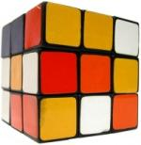
SAMPLE CUBE
Date
Total annual sales
of TV in U.S.A.
1Qtr
2Qtr
3Qtr
4Qtr
sum
Product
TV
Total annual sales
of PC in U.S.A.
PC
U.S.A
VCR
Total sales
In U.S.A
Total annual sales
of VCR in U.S.A.
Total Q1 sales
In U.S.A
sum
Canada
Total sales
In Canada
Country
Total Q1 sales
In Canada
Mexico
Total Q1 sales
In Mexico
Total sales
In Mexico
sum
Total Q2 sales
In all countries
TOTAL SALES
Total Q1 sales
In all countries
All, All, All

Slide 4
Sampling
Sampling is the main technique employed for data selection.
It is often used for both the preliminary investigation of the data and the final data analysis.
Statisticians sample because obtaining the entire set of data of interest is too expensive or time consuming.
Sampling is used in data mining because processing the entire set of data of interest is too expensive or time consuming.

Slide 5
Sampling …
The key principle for effective sampling is the following:
using a sample will work almost as well as using the entire data sets, if the sample is representative
A sample is representative if it has approximately the same property (of interest) as the original set of data

Slide 6
Types of Sampling
Simple Random Sampling
There is an equal probability of selecting any particular item
Sampling without replacement
As each item is selected, it is removed from the population
Sampling with replacement
Objects are not removed from the population as they are selected for the sample.
In sampling with replacement, the same object can be picked up more than once
Stratified sampling
Split the data into several partitions; then draw random samples from each partition

Slide 7
Sampling
Allow a mining algorithm to run in complexity that is potentially sub-linear to the size of the data
Choose a representative subset of the data
Simple random sampling may have very poor performance in the presence of skew
Develop adaptive sampling methods
Stratified sampling:
Approximate the percentage of each class (or subpopulation of interest) in the overall database
Used in conjunction with skewed data
Sampling may not reduce database I/Os (page at a time).

Slide 8
Sampling
SRSWOR
(simple random
sample without
replacement)
SRSWR
Raw Data

Slide 9
Sampling
Raw Data
Cluster/Stratified Sample

Slide 10

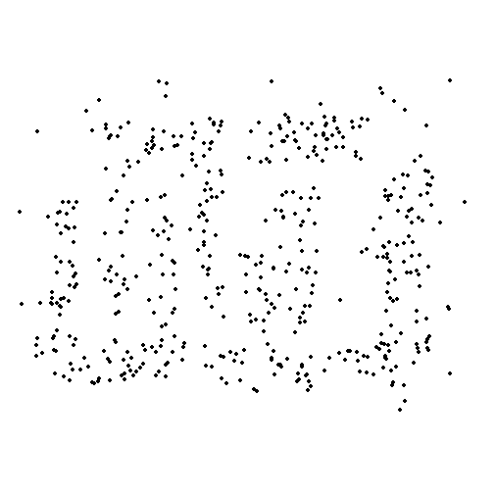
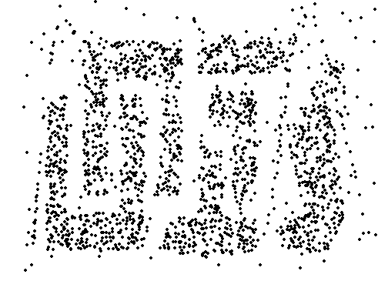
Sample Size
8000 points 2000 Points 500 Points

Slide 11
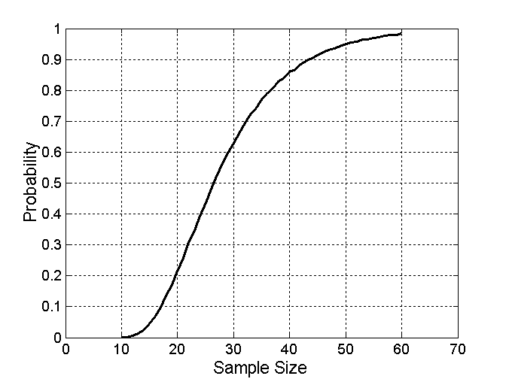

Sample Size
What sample size is necessary to get at least one object from each of 10 groups.

Slide 12
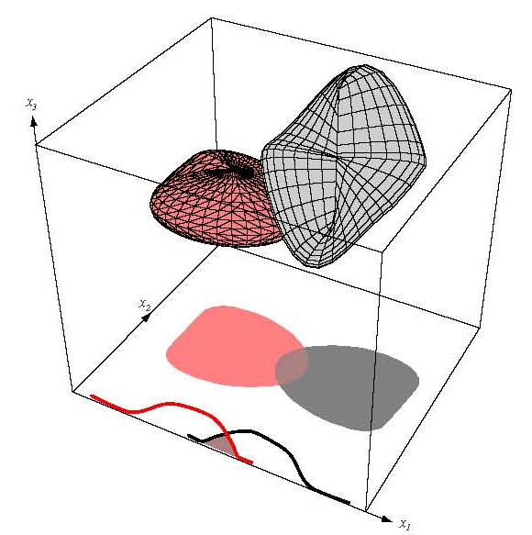
Data Dimensionality
From a theoretical point of view, increasing the number of features should lead to better performance.
In practice, the inclusion
of more features leads to
worse performance (i.e., curse
of dimensionality).
The number of training examples required
increases exponentially with dimensionality.

Slide 13
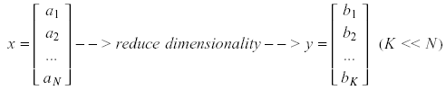
Dimensionality Reduction
Significant improvements can be achieved by first mapping the data into a lower-dimensional space.
Dimensionality can be reduced by:
Combining features using a linear or non-linear transformations.
Selecting a subset of features (i.e., feature selection).

Slide 14
Dimensionality Reduction
Purpose:
Avoid curse of dimensionality
Reduce amount of time and memory required by data mining algorithms
Allow data to be more easily visualized
May help to eliminate irrelevant features or reduce noise
Techniques
Principle Component Analysis
Singular Value Decomposition
Others: supervised and non-linear techniques

Slide 15
Example of Decision Tree Induction
Initial attribute set:
{A1, A2, A3, A4, A5, A6}
A4 ?
A1?
A6?
Class 1
Class 2
Class 1
Class 2
>
Reduced attribute set: {A1, A4, A6}

Slide 16
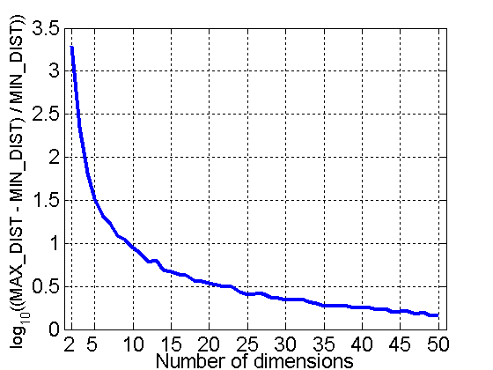
Curse of Dimensionality
When dimensionality increases, data becomes increasingly sparse in the space that it occupies
Definitions of density and distance between points, which is critical for clustering and outlier detection, become less meaningful
Randomly generate 500 points
Compute difference between max and min distance between any pair of points

Slide 17
Dimensionality Reduction (cont’d)
Linear combinations are particularly attractive because they are simple to compute and analytically tractable.
Given x ϵ R^{N}, the goal is to find an N x K matrix U such that:
y = U^{T}x ϵ R^{K} where K<<N
U^{T}

Slide 18


Dimensionality Reduction (cont’d)
Idea: represent data in terms of basis vectors in a lower dimensional space (embedded within the original space).
(1) Higher-dimensional space representation:
(2) Lower-dimensional sub-space representation:

Slide 19
Principal Component Analysis
Given N data vectors from k-dimensions, find c ≤ k orthogonal vectors that can be best used to represent data
The original data set is reduced to one consisting of N data vectors on c principal components (reduced dimensions)
Each data vector is a linear combination of the c principal component vectors
Works for numeric data only
Used when the number of dimensions is large

Slide 20
Principal Component Analysis
X2
Y1
Y2
X1

Slide 21
Dimensionality Reduction: PCA
Goal is to find a projection that captures the largest amount of variation in data
x₂
e
x₁

Slide 22
Dimensionality Reduction: PCA
Find the eigenvectors of the covariance matrix
The eigenvectors define the new space
x₂
e
x₁

Slide 23
Dimensionality Reduction: PCA

Slide 24
PCA: Motivation
Choose directions such that a total variance of data will be maximum
Maximize Total Variance
Choose directions that are orthogonal
Minimize correlation
Choose k<d orthogonal directions which maximize total variance

Slide 25
Principal Component Analysis (PCA)
Dimensionality reduction implies information loss; PCA preserves as much information as possible by minimizing the reconstruction error:
How should we determine the “best” lower dimensional space?
The “best” low-dimensional space can be determined by the “best” eigenvectors of the covariance matrix of the data (i.e., the eigenvectors corresponding to the “largest” eigenvalues – also called “principal components”).

Slide 26
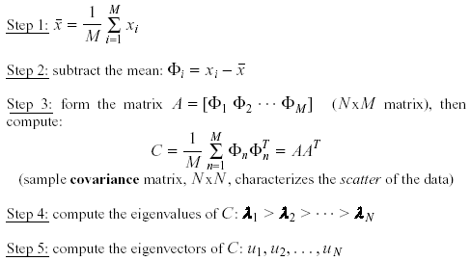
PCA - Steps
Suppose x₁, x₂, ..., x_{M} are N x 1 vectors
(i.e., center at zero)

Slide 27
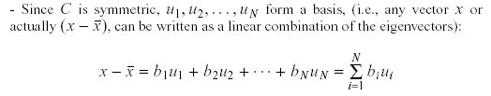

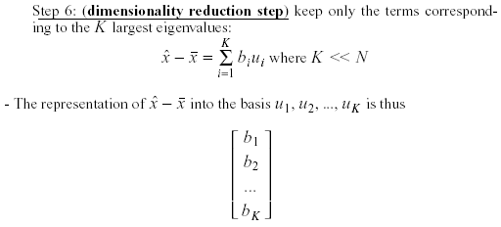
PCA – Steps (cont’d)
an orthogonal basis
where

Slide 28
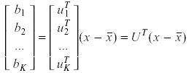
PCA – Linear Transformation
If u_{i} has unit length:
The linear transformation R^{N} → R^{K} that performs the dimensionality reduction is:

Slide 29
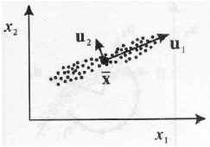
Geometric interpretation
PCA projects the data along the directions where the data varies most.
These directions are determined by the eigenvectors of the covariance matrix corresponding to the largest eigenvalues.
The magnitude of the eigenvalues corresponds to the variance of the data along the eigenvector directions.

Slide 30

How to choose K?
Choose K using the following criterion : Proportion of Variance (PoV)
In this case, we say that we “preserve” 90% or 95% of the information (variance) in the data.
If K=N, then we “preserve” 100% of the information in the data.
Scree graph plots of PoV vs k, stop at “elbow”

Slide 31
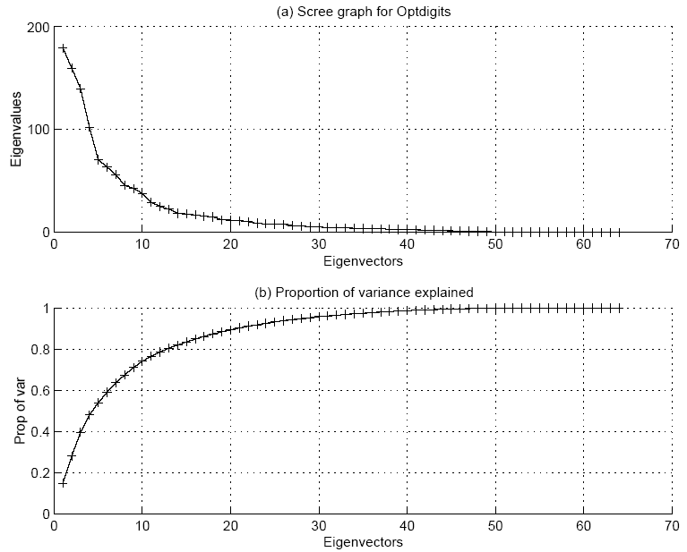

Slide 32


Error due to dimensionality reduction
The original vector x can be reconstructed using its principal components:
PCA minimizes the reconstruction error:
It can be shown that the reconstruction error is:

Slide 33
Feature Subset Selection
Another way to reduce dimensionality of data
Redundant features
duplicate much or all of the information contained in one or more other attributes
Example: purchase price of a product and the amount of sales tax paid
Irrelevant features
contain no information that is useful for the data mining task at hand
Example: students' ID is often irrelevant to the task of predicting students' GPA

Slide 34
Feature Subset Selection
Techniques:
Brute-force approach:
Try all possible feature subsets as input to data mining algorithm
Embedded approaches:
Feature selection occurs naturally as part of the data mining algorithm
Filter approaches:
Features are selected before data mining algorithm is run
Wrapper approaches:
Use the data mining algorithm as a black box to find best subset of attributes

Slide 35
Feature Subset Selection Process

Slide 36
Feature Creation
Create new attributes that can capture the important information in a data set much more efficiently than the original attributes
Three general methodologies:
Feature Extraction
domain-specific
Mapping Data to New Space
Feature Construction
combining features

Slide 38
Dimensionality Reduction
Feature selection (i.e., attribute subset selection):
Select a minimum set of features such that the probability distribution of different classes given the values for those features is as close as possible to the original distribution given the values of all features
reduce # of patterns in the patterns, easier to understand
Heuristic methods (due to exponential # of choices):
step-wise forward selection
step-wise backward elimination
combining forward selection and backward elimination
decision-tree induction

Slide 39
Heuristic Feature Selection Methods
There are 2^{d} possible sub-features of d features
Several heuristic feature selection methods:
Best single features under the feature independence assumption: choose by significance tests.
Best step-wise feature selection:
The best single-feature is picked first
Then next best feature condition to the first, ...
Step-wise feature elimination:
Repeatedly eliminate the worst feature
Best combined feature selection and elimination:
Optimal branch and bound:
Use feature elimination and backtracking

Slide 40
Dimensionality of input
Number of Observables (e.g. age and income)
If number of observables is increased
More time to compute
More memory to store inputs and intermediate results
More complicated explanations (knowledge from learning)
Regression from 100 vs. 2 parameters
No simple visualization
2D vs. 10D graph
Need much more data (curse of dimensionality)

Slide 41
Dimensionality reduction
Some features (dimensions) bear little or nor useful information (e.g. color of hair for a car selection)
Can drop some features
Have to estimate which features can be dropped from data
Several features can be combined together without loss or even with gain of information (e.g. income of all family members for loan application)
Some features can be combined together
Have to estimate which features to combine from data

Slide 42
Feature Selection vs Extraction
Feature selection: Choosing k<d important features, ignoring the remaining d – k
Subset selection algorithms
Feature extraction: Project the original x_{i} , i =1,...,d dimensions to new k<d dimensions, z_{j} , j =1,...,k
Principal Components Analysis (PCA)
Linear Discriminant Analysis (LDA)
Factor Analysis (FA)

Slide 43
Data Integration
Data integration:
combines data from multiple sources into a coherent store
Schema integration
integrate metadata from different sources
Entity identification problem: identify real world entities from multiple data sources, e.g., A.cust-id ≡ B.cust-#
Detecting and resolving data value conflicts
for the same real world entity, attribute values from different sources are different
possible reasons: different representations, different scales, e.g., metric vs. British units

Slide 44
Handling Redundancy in Data Integration
Redundant data occur often when integration of multiple databases
The same attribute may have different names in different databases
One attribute may be a “derived” attribute in another table, e.g., annual revenue
Redundant data may be able to be detected by correlational analysis
Careful integration of the data from multiple sources may help reduce/avoid redundancies and inconsistencies and improve mining speed and quality

Slide 45
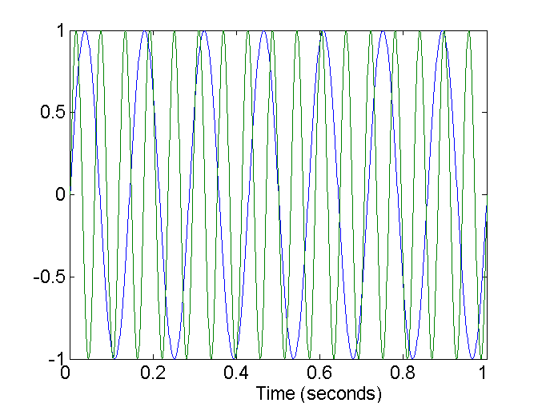
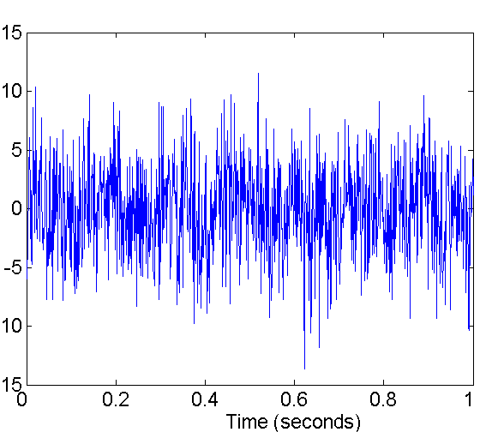
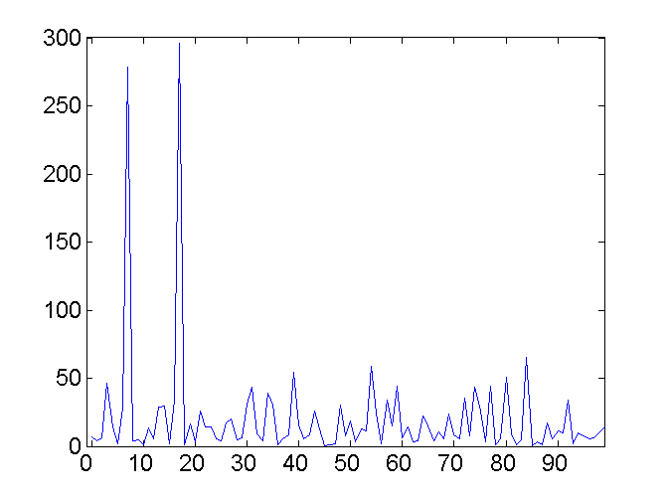
Mapping Data to a New Space
Fourier transform
Wavelet transform
Two Sine Waves
Two Sine Waves + Noise
Frequency

Slide 46
Discretization
Three types of attributes:
Nominal — values from an unordered set
Ordinal — values from an ordered set
Continuous — real numbers
Discretization:
divide the range of a continuous attribute into intervals
Some classification algorithms only accept categorical attributes.
Reduce data size by discretization
Prepare for further analysis

Slide 47
Discretization and Concept hierachy
Discretization
reduce the number of values for a given continuous attribute by dividing the range of the attribute into intervals. Interval labels can then be used to replace actual data values
Concept hierarchies
reduce the data by collecting and replacing low level concepts (such as numeric values for the attribute age) by higher level concepts (such as young, middle-aged, or senior)

Slide 48
Concept Hierarchy Generation for Categorical Data
Specification of a partial ordering of attributes explicitly at the schema level by users or experts
street<city<state<country
Specification of a portion of a hierarchy by explicit data grouping
{Urbana, Champaign, Chicago}<Illinois
Specification of a set of attributes.
System automatically generates partial ordering by analysis of the number of distinct values
E.g., street < city <state < country
Specification of only a partial set of attributes
E.g., only street < city, not others

Slide 49
Automatic Concept Hierarchy Generation
Some concept hierarchies can be automatically generated based on the analysis of the number of distinct values per attribute in the given data set
The attribute with the most distinct values is placed at the lowest level of the hierarchy
Note: Exception—weekday (7), month(12), year(may be last 20 years data)
country
15 distinct values
province_or_ state
65 distinct values
city
3567 distinct values
street
674,339 distinct values

Slide 50
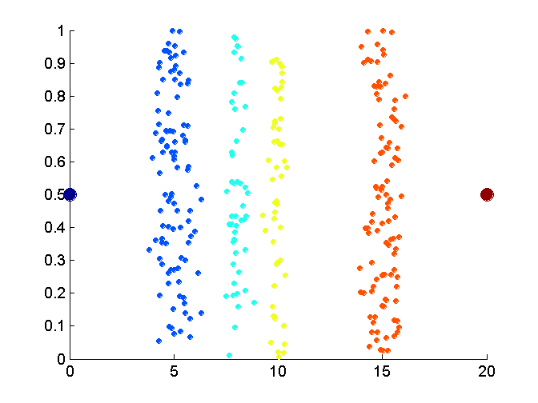
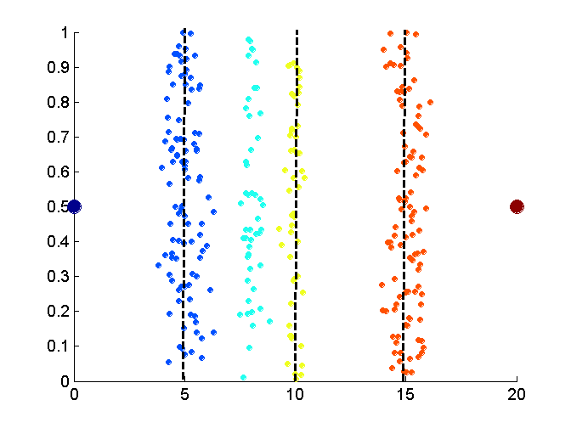
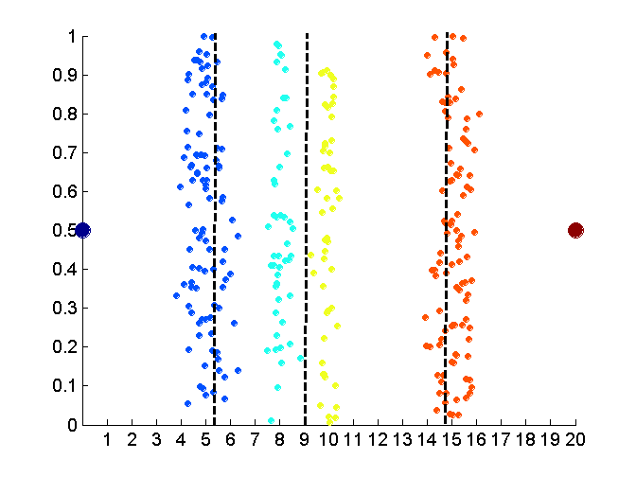
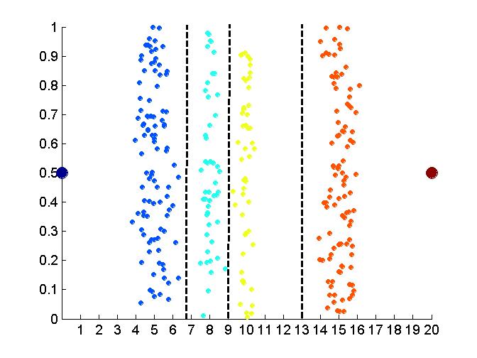
Discretization Without Using Class Labels
Data
Equal interval width
Equal frequency
K-means

Slide 51
Entropy-based discretization
Information-based measure – entropy
Recursively partition the values of a numeric attribute (hierarchical discretization)
Method: Given a set of tuples, S, basic method for entropy-based discretization of A (attribute) is as follows:

Slide 52
Cont’d
Each value of A can be considered a potential interval boundary or threshold T. For example, a value v of A can partition the samples in S into two subsets satisfying the condition A < v and A >= v – binary discretization
Given S, the threshold value selected if the one that maximizes the information gain resulting from subsequent partitioning.

Slide 53
Information gain
S₁ and S₂ – the samples in S satisfying the condition A < T and A >=T

Slide 54
Entropy function
Ent for a given set is calculated based on the class distribution of the samples in the set. Eg, given m classes, the entropy of S₁ is
P_{i} – probability of class i in S₁, determined by dividing the number of samples of class i in S₁ by the total number of samples in S₁

Slide 55
Entropy-based (1)
Given attribute-value/class pairs:
(0,P), (4,P), (12,P), (16,N), (16,N), (18,P), (24,N), (26,N), (28,N)
Entropy-based binning via binarization:
Intuitively, find best split so that the bins are as pure as possible
Formally characterized by maximal information gain.
Let S denote the above 9 pairs, p=4/9 be fraction of P pairs, and n=5/9 be fraction of N pairs.
Entropy(S) = - p log p - n log n.
Smaller entropy – set is relatively pure; smallest is 0.
Large entropy – set is mixed. Largest is 1.

Slide 56
Entropy-based (2)
Let v be a possible split. Then S is divided into two sets:
S1: value <= v and S2: value > v
Information of the split:
I(S1,S2) = (|S1|/|S|) Entropy(S1)+ (|S2|/|S|) Entropy(S2)
Goal: split with maximal information gain.
Possible splits: mid points b/w any two consecutive values.

Slide 57
Cont.
For v=14
I(S1,S2) = 0 + 6/9*Entropy(S2)
= 6/9 * 0.65
= 0.433
The best split is found after examining all possible splits.
Try for v 16, find I(S1,S2) ?
The process of determining a threshold value is recursively applied until the following stopping criteria
The above example no more splitting because S1&S@ contains purely class, i.e., all P and all N

Slide 58
Example: fair coin throw
P (head) = 0.5
P (tail) = 0.5
Example: Coin Flip
A_{X} = {heads, tails}
P(heads) = P(tails) = ½
½ log₂(½) = ½ * - 1
H(X) = 1

Slide 59
Example: biased coin throw
What about a two-headed coin?
Conditional Entropy:
P(head) | 0.5 | 0.25 | 0.1 | 0
P(tail) | 0.5 | 0.75 | 0.9 | 1
Entropy | 1 | 0.811 | 0.469 | 0.000

Slide 60
Entropy of a split
Information in a split with x items of one class, y items of the second class

Slide 61
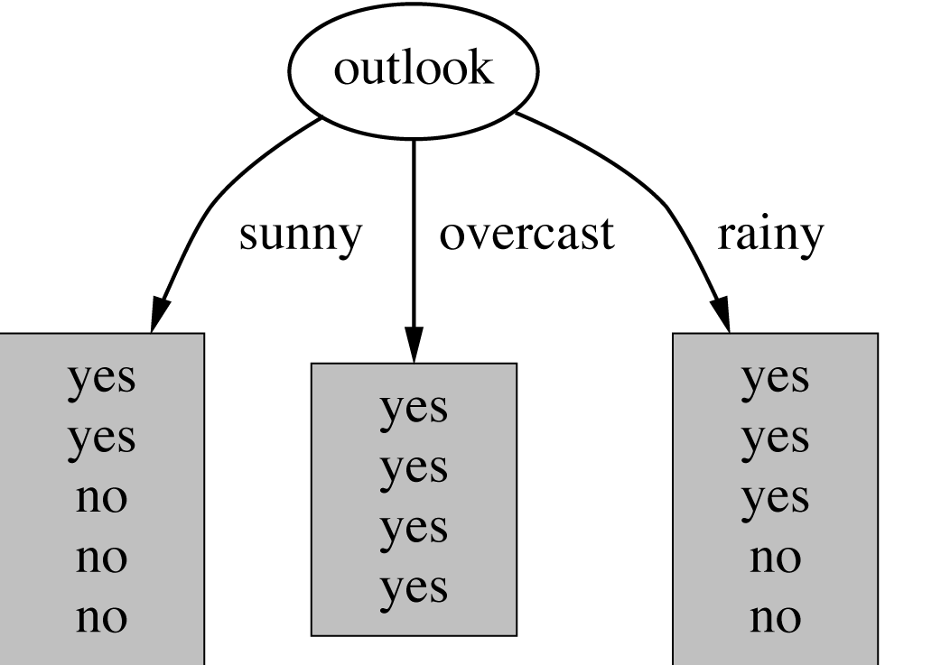
Example: attribute “Outlook”
“Outlook” = “Sunny”: 2 and 3 split

Slide 62
Outlook = Overcast
“Outlook” = “Overcast”: 4/0 split
Note: log(0) is not defined, but we evaluate 0*log(0) as zero

Slide 63
Outlook = Rainy
“Outlook” = “Rainy”:

Slide 64
Expected Information
Expected information for attribute:

Slide 65
Computing the information gain
Information gain:
(information before split) – (information after split)
Information gain for attributes from weather data:

Slide 66
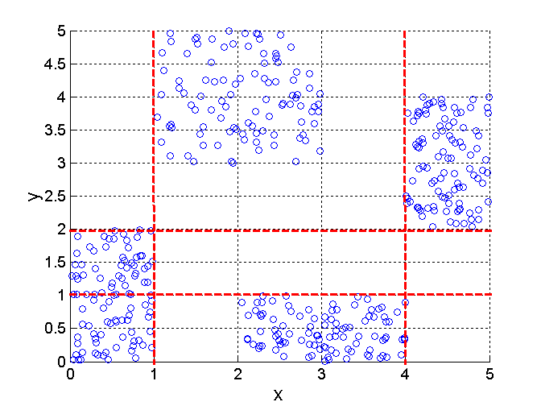
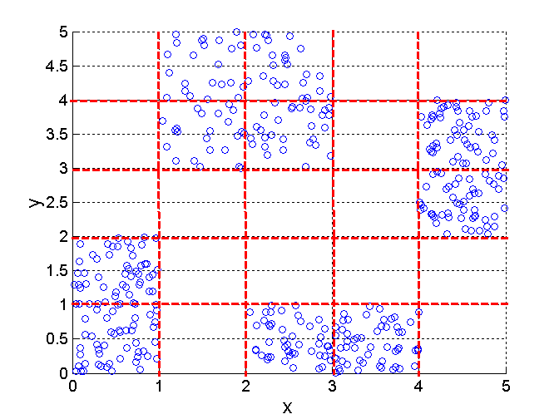
Discretization Using Class Labels
Entropy based approach
3 categories for both x and y
5 categories for both x and y

Slide 67
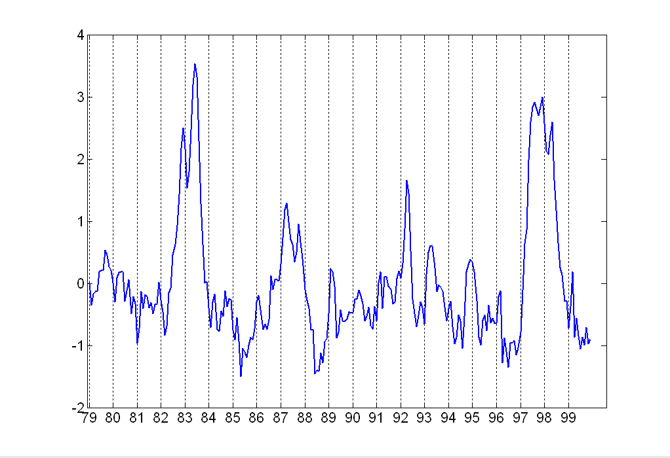
Attribute Transformation
A function that maps the entire set of values of a given attribute to a new set of replacement values such that each old value can be identified with one of the new values
Simple functions: x^{k}, log(x), e^{x}, |x|
Standardization and Normalization

Slide 68
Numerosity Reduction
Reduce the data volume by choosing alternative ‘smaller’ forms of data representation
Two type:
Parametric – a model is used to estimate the data, only the data parameters is stored instead of actual data
regression
log-linear model
Nonparametric –storing reduced representation of the data
Histograms
Clustering
Sampling

Slide 69
Regression and Log-Linear Models
Linear regression: Data are modeled to fit a straight line
Often uses the least-square method to fit the line
Multiple regression: allows a response variable Y to be modeled as a linear function of multidimensional feature vector
Log-linear model: approximates discrete multidimensional probability distributions

Slide 70
Regression
Develop a model to predict the salary of college graduates with 10 years working experience
Potential sales of a new product given its price
Regression - used to approximate the given data
The data are modeled as a straight line.
A random variable Y (response variable), can be modeled as a linear function of another random variable, X (predictor variable), with the equation

Slide 71
Cont’d
The variance of Y is assumed to be constant
α and β (regression coefficients) – Y-intercept and the slope line.
Can be solved by the method of least squares. (minimizes the error between actual line separating data and the estimate of the line)

Slide 72
Cont’d

Slide 73
Regress Analysis and Log-Linear Models
Linear regression: Y = α + β X
Two parameters , α and β specify the line and are to be estimated by using the data at hand.
using the least squares criterion to the known values of Y1, Y2, …, X1, X2, ….
Multiple regression: Y = b0 + b1 X1 + b2 X2.
Many nonlinear functions can be transformed into the above.
Log-linear models:
The multi-way table of joint probabilities is approximated by a product of lower-order tables.
Probability: p(a, b, c, d) = αab βacχad δbcd

Slide 74
Histograms
A popular data reduction technique
Divide data into buckets and store average (sum) for each bucket
Can be constructed optimally in one dimension using dynamic programming
Related to quantization problems.

Slide 75
Clustering
Partition data set into clusters, and one can store cluster representation only
Can be very effective if data is clustered but not if data is “smeared”
Can have hierarchical clustering and be stored in multi-dimensional index tree structures
There are many choices of clustering definitions and clustering algorithms, further detailed in Chapter 8

Slide 76
Data Compression
String compression
There are extensive theories and well-tuned algorithms
Typically lossless
But only limited manipulation is possible without expansion
Audio/video compression
Typically lossy compression, with progressive refinement
Sometimes small fragments of signal can be reconstructed without reconstructing the whole

Slide 77
Data Compression
Original Data
Compressed
Data
lossless
Original Data
Approximated
lossy

Slide 78
Wavelet Transformation
Haar2
Daubechie4
Discrete wavelet transform (DWT): linear signal processing, multi-resolutional analysis
Compressed approximation: store only a small fraction of the strongest of the wavelet coefficients
Similar to discrete Fourier transform (DFT), but better lossy compression, localized in space
Method:
Length, L, must be an integer power of 2 (padding with 0s, when necessary)
Each transform has 2 functions: smoothing, difference
Applies to pairs of data, resulting in two set of data of length L/2
Applies two functions recursively, until reaches the desired length

